Slide 1
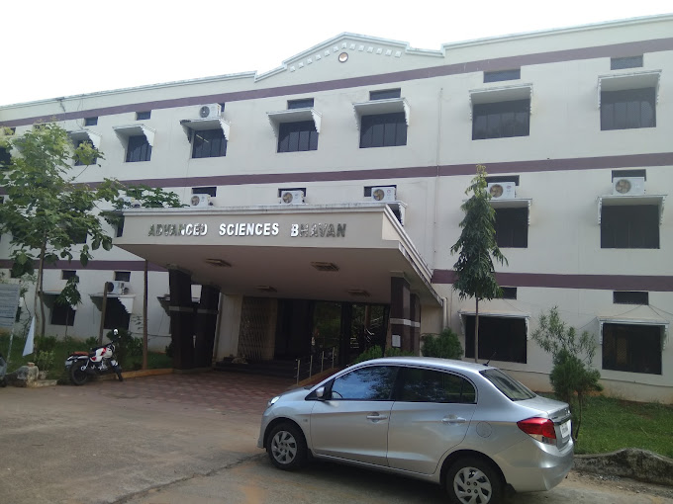
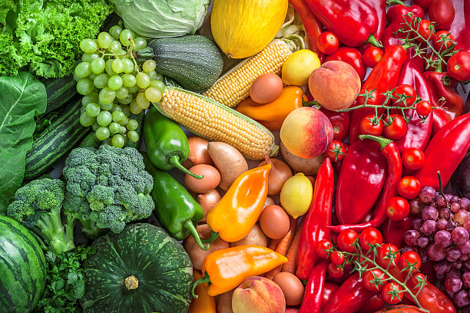
WELCOME TO NAAC PEER TEAM
Department of Food, Nutrition & Dietetics
Andhra University
Visakhapatnam

Slide 2
DEPARTMENT PROFILE
Department of Food, Nutrition Dietetics, Andhra University was established in the year 2008
The founder of the Department was former Vice-Chancellor
Prof. L. Venugopala Reddy
Prof. D. Gowri Shankar was the first Head of the Department

Slide 3
To create new frontiers of knowledge in quest for development of the humane and just society
VISION
MISSION
To Stimulate the academic for promotion of quality of teaching, learning and research.
To undertake quality related research studies, consultancy and training programs.
To foster global competencies among students and to inculcate value system in them.
To promote the use of state-of-the-art technology and quest for excellence.

Slide 4
Programs offered
1) 4 Year B.Sc. (Honors)+1 Year M.Sc. Food Science & Technology Program (Multiple Entry and Exit Mode)
2) M.Sc. Food, Nutrition & Dietetics
3) Ph.D. Food, Nutrition & Dietetics

Slide 5
Courses offered
SEMESTER I
SEMESTER II
SEMESTER III
SEMESTER IV
FND 1.1 Food Chemistry
FND1.2 Food Science
FND 1.3 Human Physiology
FND1.4 Advanced Nutrition I
FND 2.1 Food Processing & Preservation Technology
FND 2.2 Food Analysis & Instrumentation
FND 2.3 Nutritional Biochemistry
FND 2.4 Advanced Nutrition II
FND 3.1 Food Microbiology & Toxicology
FND 3.2 Clinical and Therapeutic Nutrition
FND 3.3 Institutional Food Administration
FND 3.4 Research Methodology & Statistics
FND 4.1 Nutrition in Critical Care & Diet Counselling
FND 4.2 Sports Nutrition
FND 1.5 Food Chemistry
FND 1.6 Food Science
FND 2.5 Food Processing & Preservation Technology
FND 2.6 Food Analysis & Instrumentation
FND 2.7 Nutritional Biochemistry
FND 2.8 Advanced Nutrition II
FND 3.5 Food Microbiology & Toxicology
FND 3.6 Clinical and Therapeutic Nutrition
FND 4.3 Nutrition in Critical Care & Diet Counselling
FND 4.4 Internship
FND 4.5 Project work & Dissertation
FND 4.6 Comprehensive Viva-voce

Slide 6
PROGRAM OUTCOMES
1
Encompass exceptional knowledge in core areas of Diet therapy, Clinical Nutrition, Food Science, Food Analysis and Nutritional management
2
Achieve cognizance in interdisciplinary fields of Food Microbiology, Food processing technology, Nutritional Biochemistry, Food safety and Sports Nutrition through knowledge fortification
3
Develop multidisciplinary proficiency in contemporary domains through availing MOOCS and value-added courses
4
Accomplish dexterity in all the fields under the umbrella of Food, Nutrition and Dietetics to attain practical competency
5
Impregnate adept expertise and hands on experience through Dissertation, project work, internship/industrial training, field trips, food institutional and industrial visits
6
Amass exploratory research skills with innovative ideas, lab to field technology, systemic approach towards achieving sustainable nutrition goals
7
Employ critical thinking towards innovation, synthesis of novel ideas, knowledge dissemination and community interaction for the benefit of the community and society at large
8
Develop problem solving, decision making and communication skills to emerge as a potential leader
9
Evolve as a professionally sound wellbeing with societal responsibility fortified with moral and ethical values well equipped for nation building

Slide 7
COURSE OUTCOMES
Understand the nutritional problems of energy imbalance
Knowledge on different nutrient requirements for different age groups
Gain knowledge on the effects of micronutrient deficiency
Understand the role of vitamin like nutrients in health and diseases
Comprehend the role of statistical analysis in food and nutritional research analysis
https://drive.google.com/file/d/13fs4eDYHhjouhaYfZTlW7KLFNwEeXdEF/view?usp=sharing

Slide 8
Semester-I, Paper-IV: Advanced Nutrition I
CO | PO1 | PO2 | PO3 | PO4 | PO5 | PO6 | PO7 | PO8 | PO9
CO1 | 3 | 2 | 3 | 3 | 2 | 3 | 3 | 3 | 3
CO2 | 3 | 2 | 2.5 | 3 | 3 | 3 | 2 | 3 | 3
CO3 | 3 | 2.5 | 3 | 3 | 2 | 3 | 3 | 3 | 3
CO4 | 3 | 3 | 3 | 2 | 2 | 3 | 3 | 2 | 3
CO5 | 3 | 2 | 3 | 3 | 3 | 3 | 3 | 3 | 3
2020-2022
Semester-I, Paper-IV: Advanced Nutrition I
CO | PO1 | PO2 | PO3 | PO4 | PO5 | PO6 | PO7 | PO8 | PO9
CO1 | 3 | 3 | 3 | 3 | 3 | 3 | 3 | 3 | 3
CO2 | 3 | 3 | 3 | 3 | 3 | 3 | 3 | 3 | 3
CO3 | 3 | 3 | 3 | 3 | 3 | 3 | 3 | 3 | 3
CO4 | 3 | 3 | 3 | 3 | 2 | 3 | 3 | 3 | 3
CO5 | 3 | 3 | 3 | 3 | 3 | 3 | 2 | 3 | 3
2021-2023

Slide 9
PO ATTAINMENTS
X-Axis = PO number
Y-Axis = PO Attainment value

Slide 10
Courses with employability/Skill development/value added programs offered
Employability
Skill development
Value added
Food Processing & Preservation Technology Food Analysis & Instrumentation Food Microbiology & Toxicology Clinical and Therapeutic Nutrition Sports Nutrition
Food Processing & Preservation Technology Food Analysis & Instrumentation Food Microbiology & Toxicology Clinical and Therapeutic Nutrition
Intellectual Property Rights Research Methodology

Slide 11
Feedback on curriculum

Slide 12
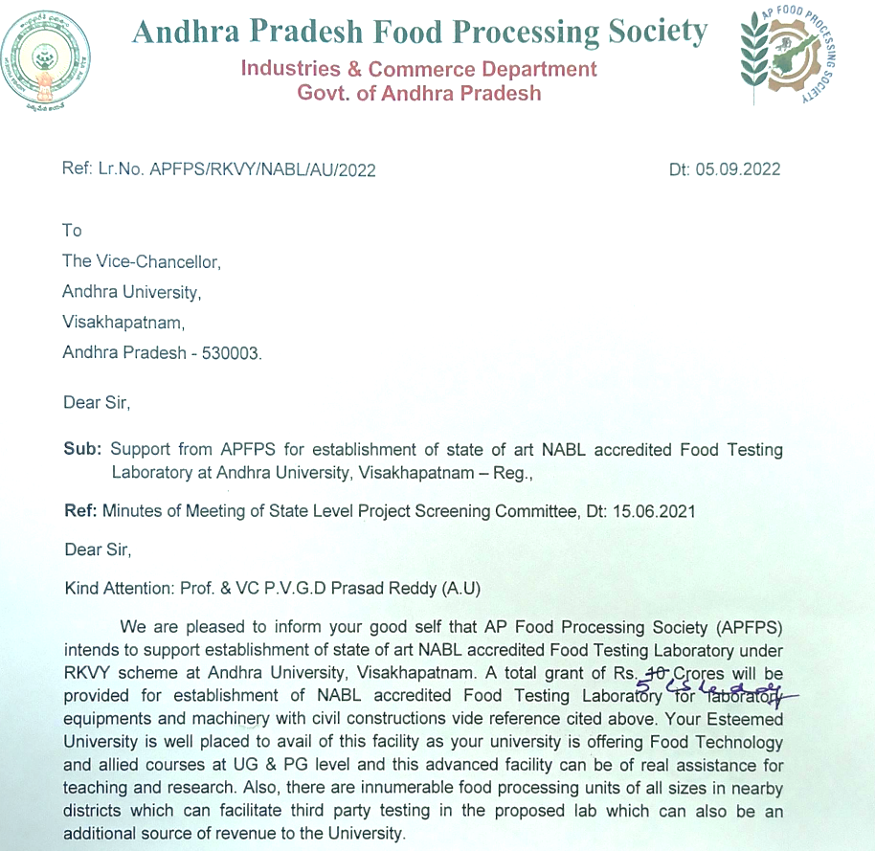
MOUs
MOU with Andhra Pradesh Food Processing Society (APFPS) for establishing NABL accredited Food testing laboratory for the benefit of Food Science & Technology students.

Slide 13
MOUs
Global Hospital, Hyderabad
Care Hospital, Visakhapatnam

Slide 14
Internship

Slide 15
Student project works
1 | Sensory evaluation and nutrient composition of MAHUA flower based products
2 | Development of functional food based blenderized tube feeds for burns patients
3 | Fortification of commonly consumed recipes with nutraceutical chitosan for value addition
4 | Value added products developed from fruit waste
5 | Development of products based on low sodium foods for hypertension
6 | Impact of COVID-19 infection on the nutrient intake, nutritional status and dietary habits in men
7 | A study of prevalence of dyslectrolytemia in critically ill patients
8 | Preparation of fruit leathers using solar dryer technology and evaluation of consumer acceptability
9 | Study on consumption patterns, nutrient composition and recipe development with little millet

Slide 16
Faculty Profile
Faculty
Dr.V.Lakshmi Associate Professor & Head
Prof. P. Gopala Krishna Adjunct Professor & BOS Chairman
Dr. M.Rajeswari Assistant Professor (c)
K.B.Kalpana (TTA)
Dr. G.V. Ramana (TTA)
B. Pujitha (TTA)
Research Publications | 96
Books/Book chapters | 7
Seminars /conference/ webinars attended | 70
Papers presented in seminars/ conferences | 21
No of Ph.Ds/ M.Phil guided | 11

Slide 17
SEMINARS & WEBINARS ORGANIZED
1
National Seminar on “Non-Alcoholic Fatty Liver Disease and Metabolic Syndrome- Recent Concerns and Life style Management” 7th and 8th December 2009
2
Work shop on Food, Nutrition and Health on the occasion of Krishna Pushkaralu 13th August 2016
3
National Seminar and workshop on Nutrition related health issues in children, Dept. of Food, Nutrition & Dietetics and Dept. of Biotechnology, 7th September 2017
4
Health and Biotechnological Applications on Food & Pharma Industries (EHBAFPI) organised by Department of Biotechnology and Food Nutrition and Dietetics, 27-28th October 2018
5
National Webinar on “Precision Nutrition- the Way Forward to Immunity challenges” 23rd June 2020
6
Precision Nutrition for Potential Adolescence - Challenges in Context of Covid -19, International Webinar, 24/09/2021 , Department of Food, Nutrition & Dietetics & National council for Women, POSHAN MAA, 24th September2021

Slide 18
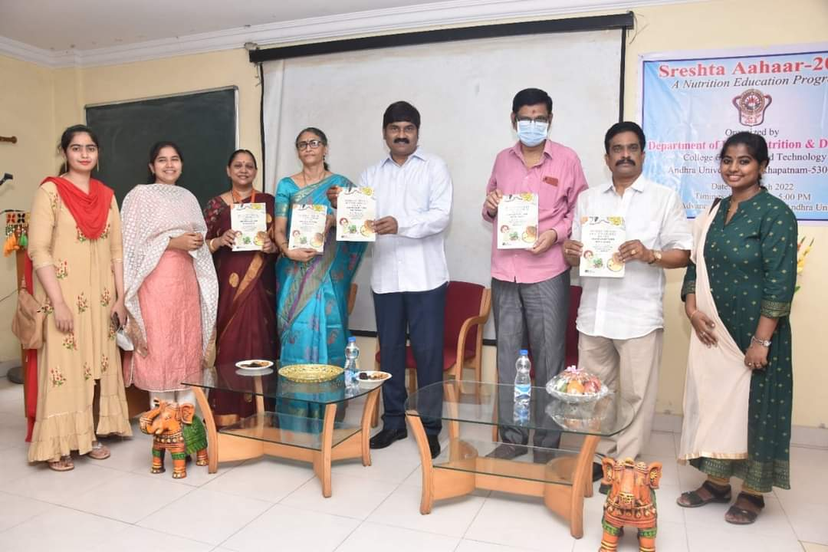
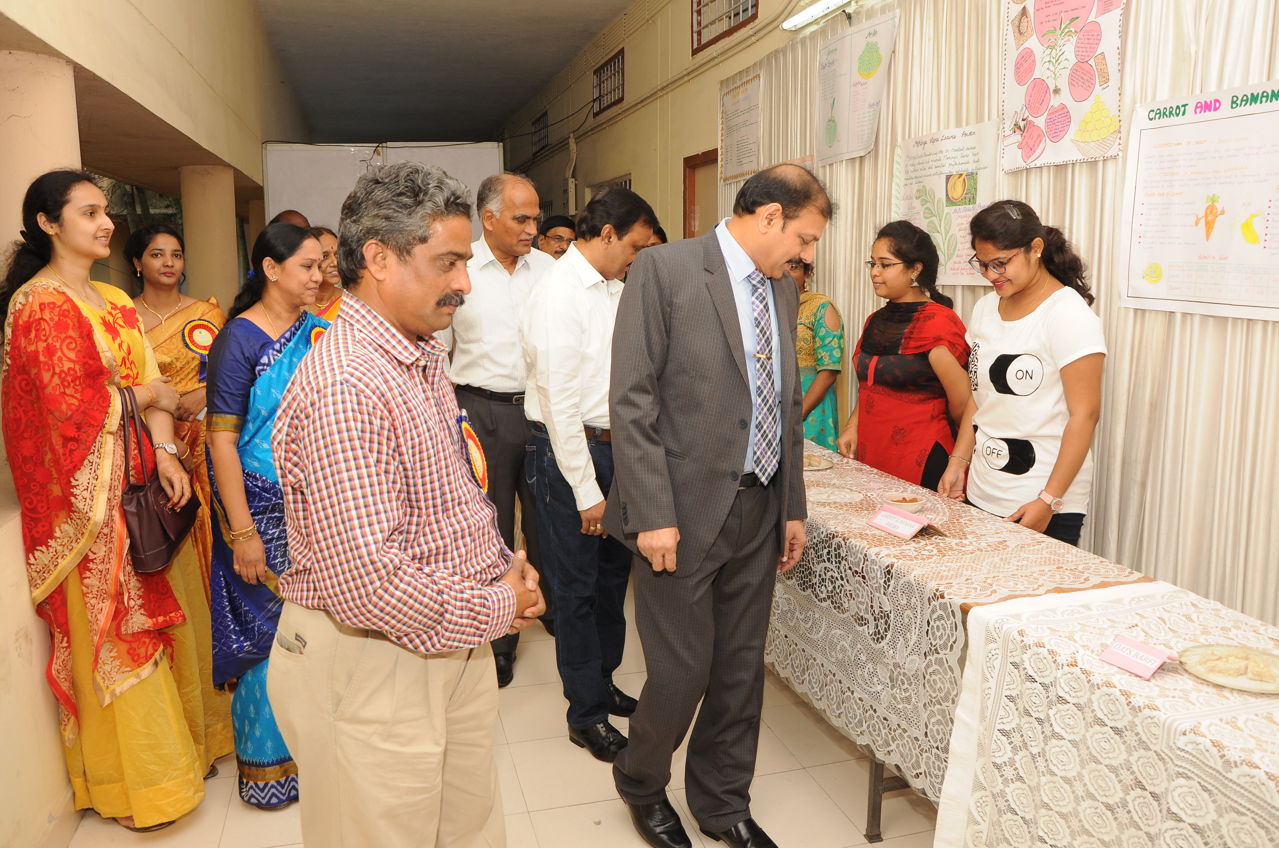
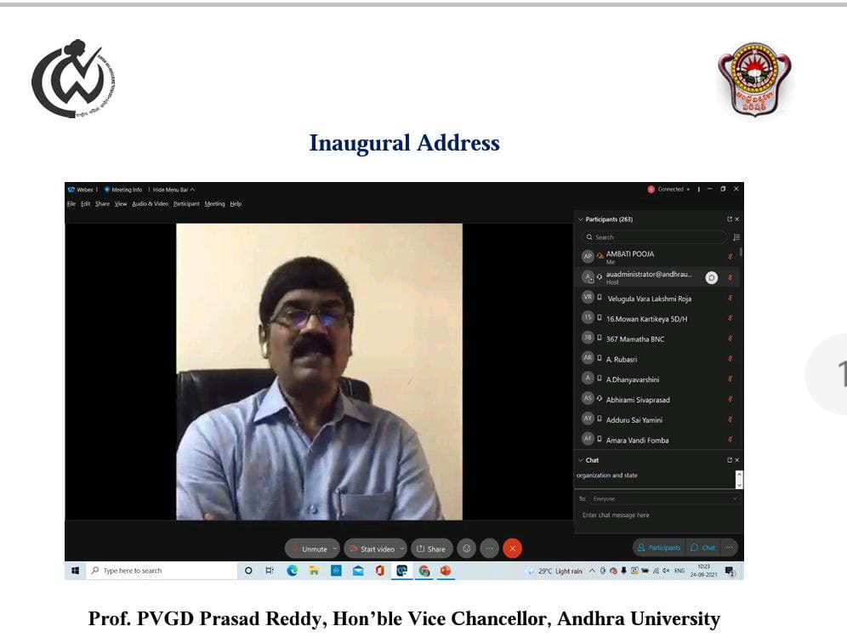
Exhibitions/Workshops organized
1-3 March 2008
(3 days)
9th August 2018
Work shop on Healthy juices
28th March 2022
Sreshta Aahaar Nutrition Education Program
Food & Nutrition exhibition involving 15 food industries
Soya Food Festival
22&23 December, 2008
(2 days)

Slide 19
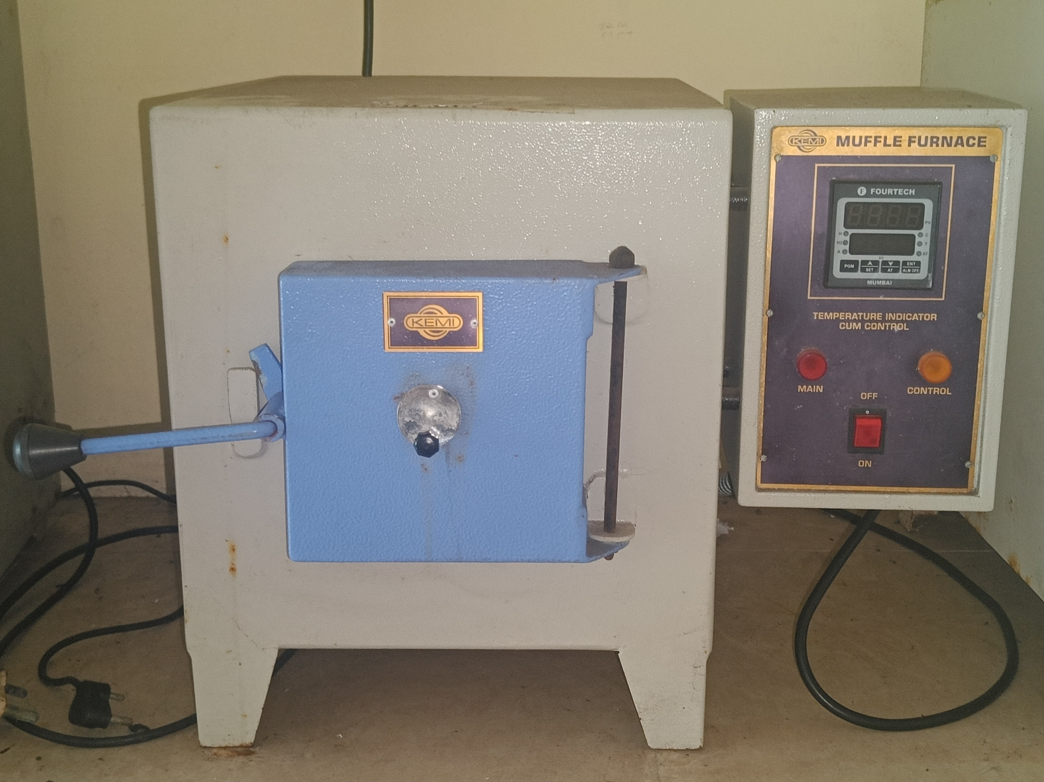
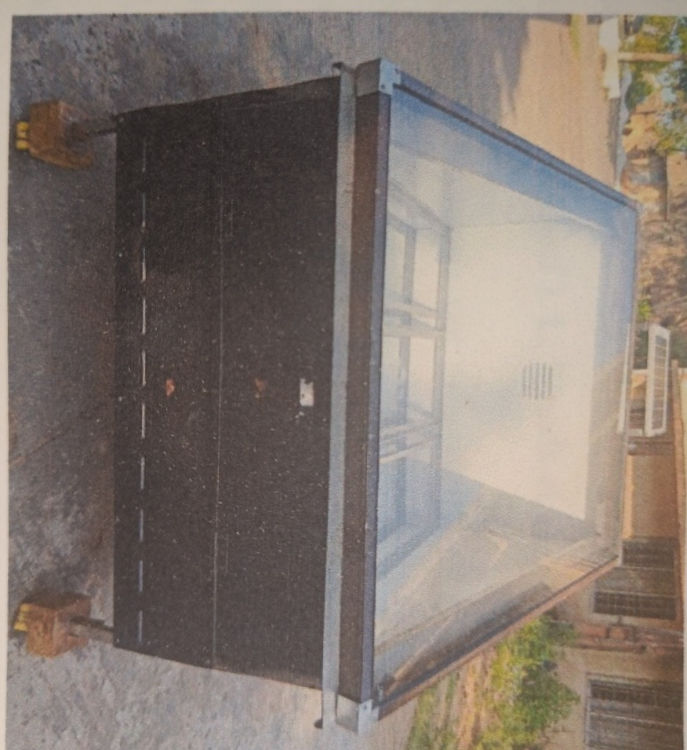
Equipment
SOLAR DRYER
MUFFLE FURNACE

Slide 20
JRF/SRF
Research Scholars
NAME | DETAILS | YEAR
K. RINI MADHURI | UGC NET JRF | 2016
AMBATI POOJA | UGC NET SRF | 2019
S. GAYATHRI | NFSC | 2023
S.No. | Name of Research Fellow | Year of Enrolment
1 | K. Neeraja | 2018
2 | S. Lydia | 2018
3 | Ambati Pooja | 2019
4 | Rahel Gizaw Maru | 2021
5 | Ch. Sushma | 2021
6 | S. Gayathri | 2022
7 | T Uma Sai Madhurya | 2023
Number of JRF/SRF
Ph.Ds awarded - 4
NAME | YEAR
Y. SUJATA | 2017
TRISHITHA ISSAR | 2018
R. REKHA | 2019
K. ANUSHA | 2020
K. RINI MADHURI | 2021

Slide 21
STUDENT STRENGTH
Academic Year | Male | Female | Total
2017-2018 | 04 | 42 | 46
2018-2019 | 02 | 44 | 46
2019-2020 | 06 | 48 | 54
2020-2021 | 08 | 56 | 64
2021-2022 | 03 | 50 | 53

Slide 22
Student Diversity

Slide 23
Student Diversity
ACADEMIC YEAR | National |  | International
 | Within state | Other states
2017-2018 | 44 | - | Nil
2018-2019 | 42 | 01 | 01
2019-2020 | 47 | 04 | 02
2020-2021 | 57 | - | 07
2021-2022 | 51 | - | 02

Slide 24
Demand Ratio
Academic year | Applications received | Seats filled | Demand ratio
2017-2018 | 2848 | 46 | 61.9
2018-2019 | 3140 | 46 | 68.2
2019-2020 | 3377 | 54 | 73.4
2020-2021 | 2687 | 63 | 58.4
2021-2022 | 2687 | 53 | 58.4

Slide 25
Mentor-Mentee Ratio
N0 of Mentors
4
students
64
Mentor-Mentee Ratio
1:16

Slide 26
Pass Percentage
Academic year | Strength | Distinction | I class | Pass percentage
2017-2018 | 46 | 45 | 1 | 100
2018-2019 | 46 | 44 | 2 | 100
2019-2020 | 54 | 45 | 10 | 100
2020-2021 | 64 | 51 | 13 | 100
2021-2022 | 53 | 50 | 02 | 98

Slide 27
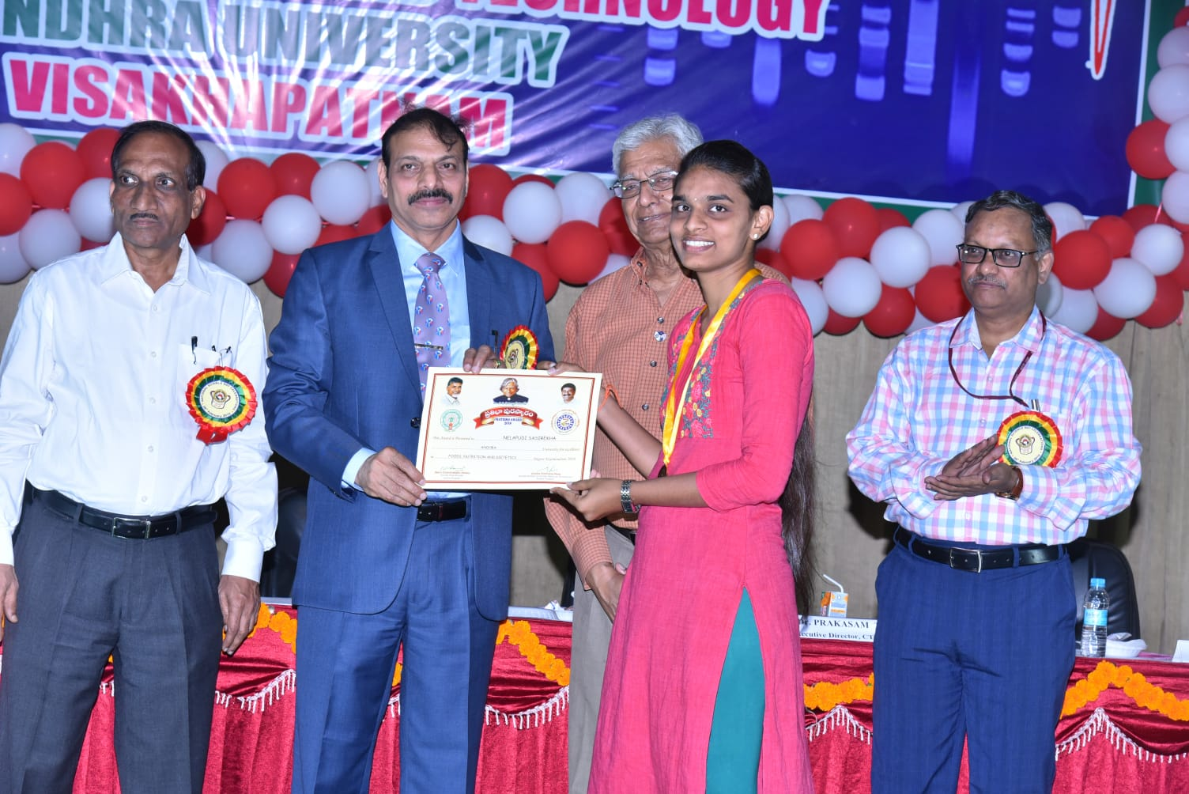
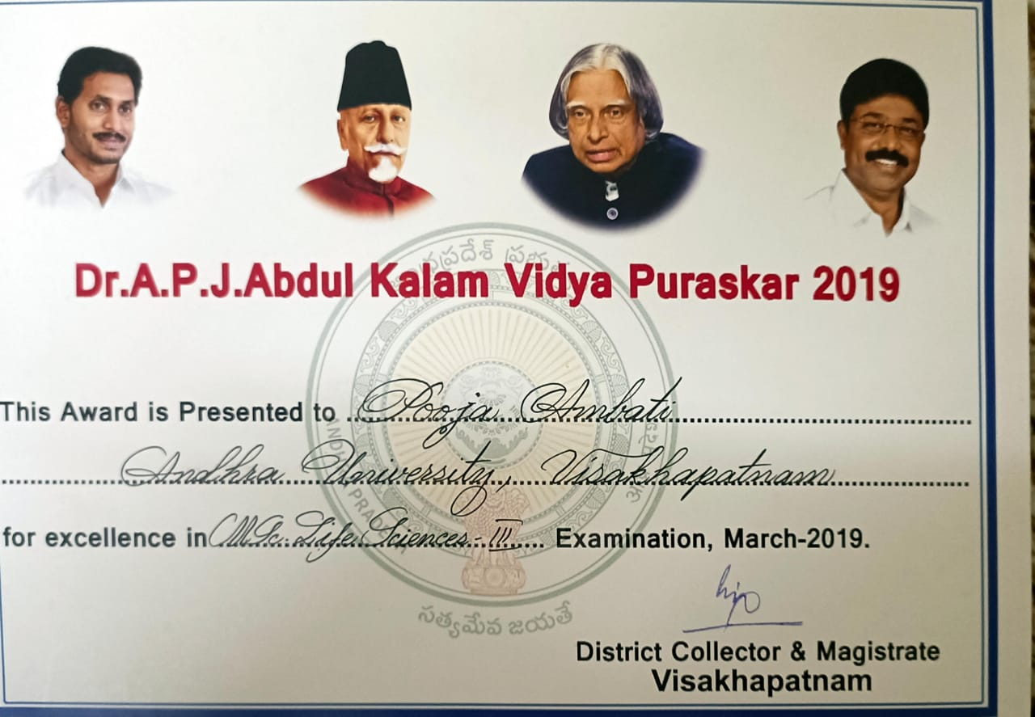
Prathibha Awards
Name of the Student | Year
Drakshayani | 2018
N Sasi Rekha | 2018
Pramoda Bhavani | 2018
Srilakshmi | 2018
G.Mounika | 2018
Satya Vani | 2018
A. Prabha Gayathri | 2019
Ambati Pooja | 2019
G. Sai Sree | 2019
D Gnyapika | 2019
K. Hema | 2019
Swathi | 2019

Slide 28
PLACEMENTS

Slide 29
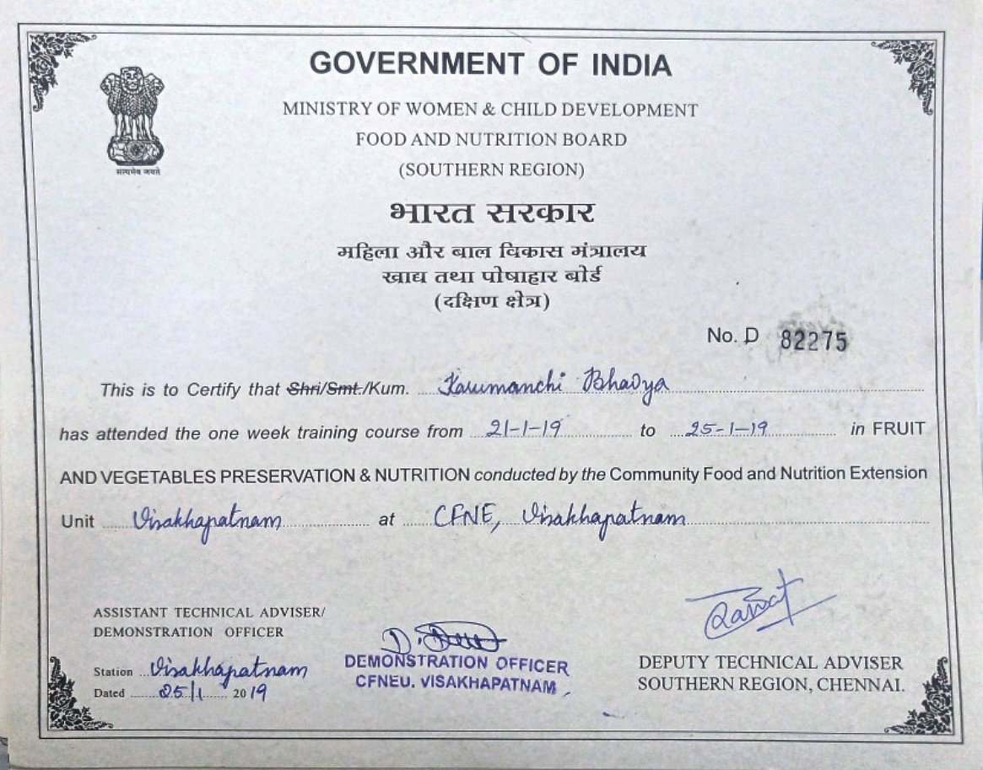
Skill development programs
Training program in Fruit and vegetable Processing Unit
https://drive.google.com/drive/folders/16pRzT2u26MKMPYm2nBc3l3jno7X03v?usp=sharing

Slide 30
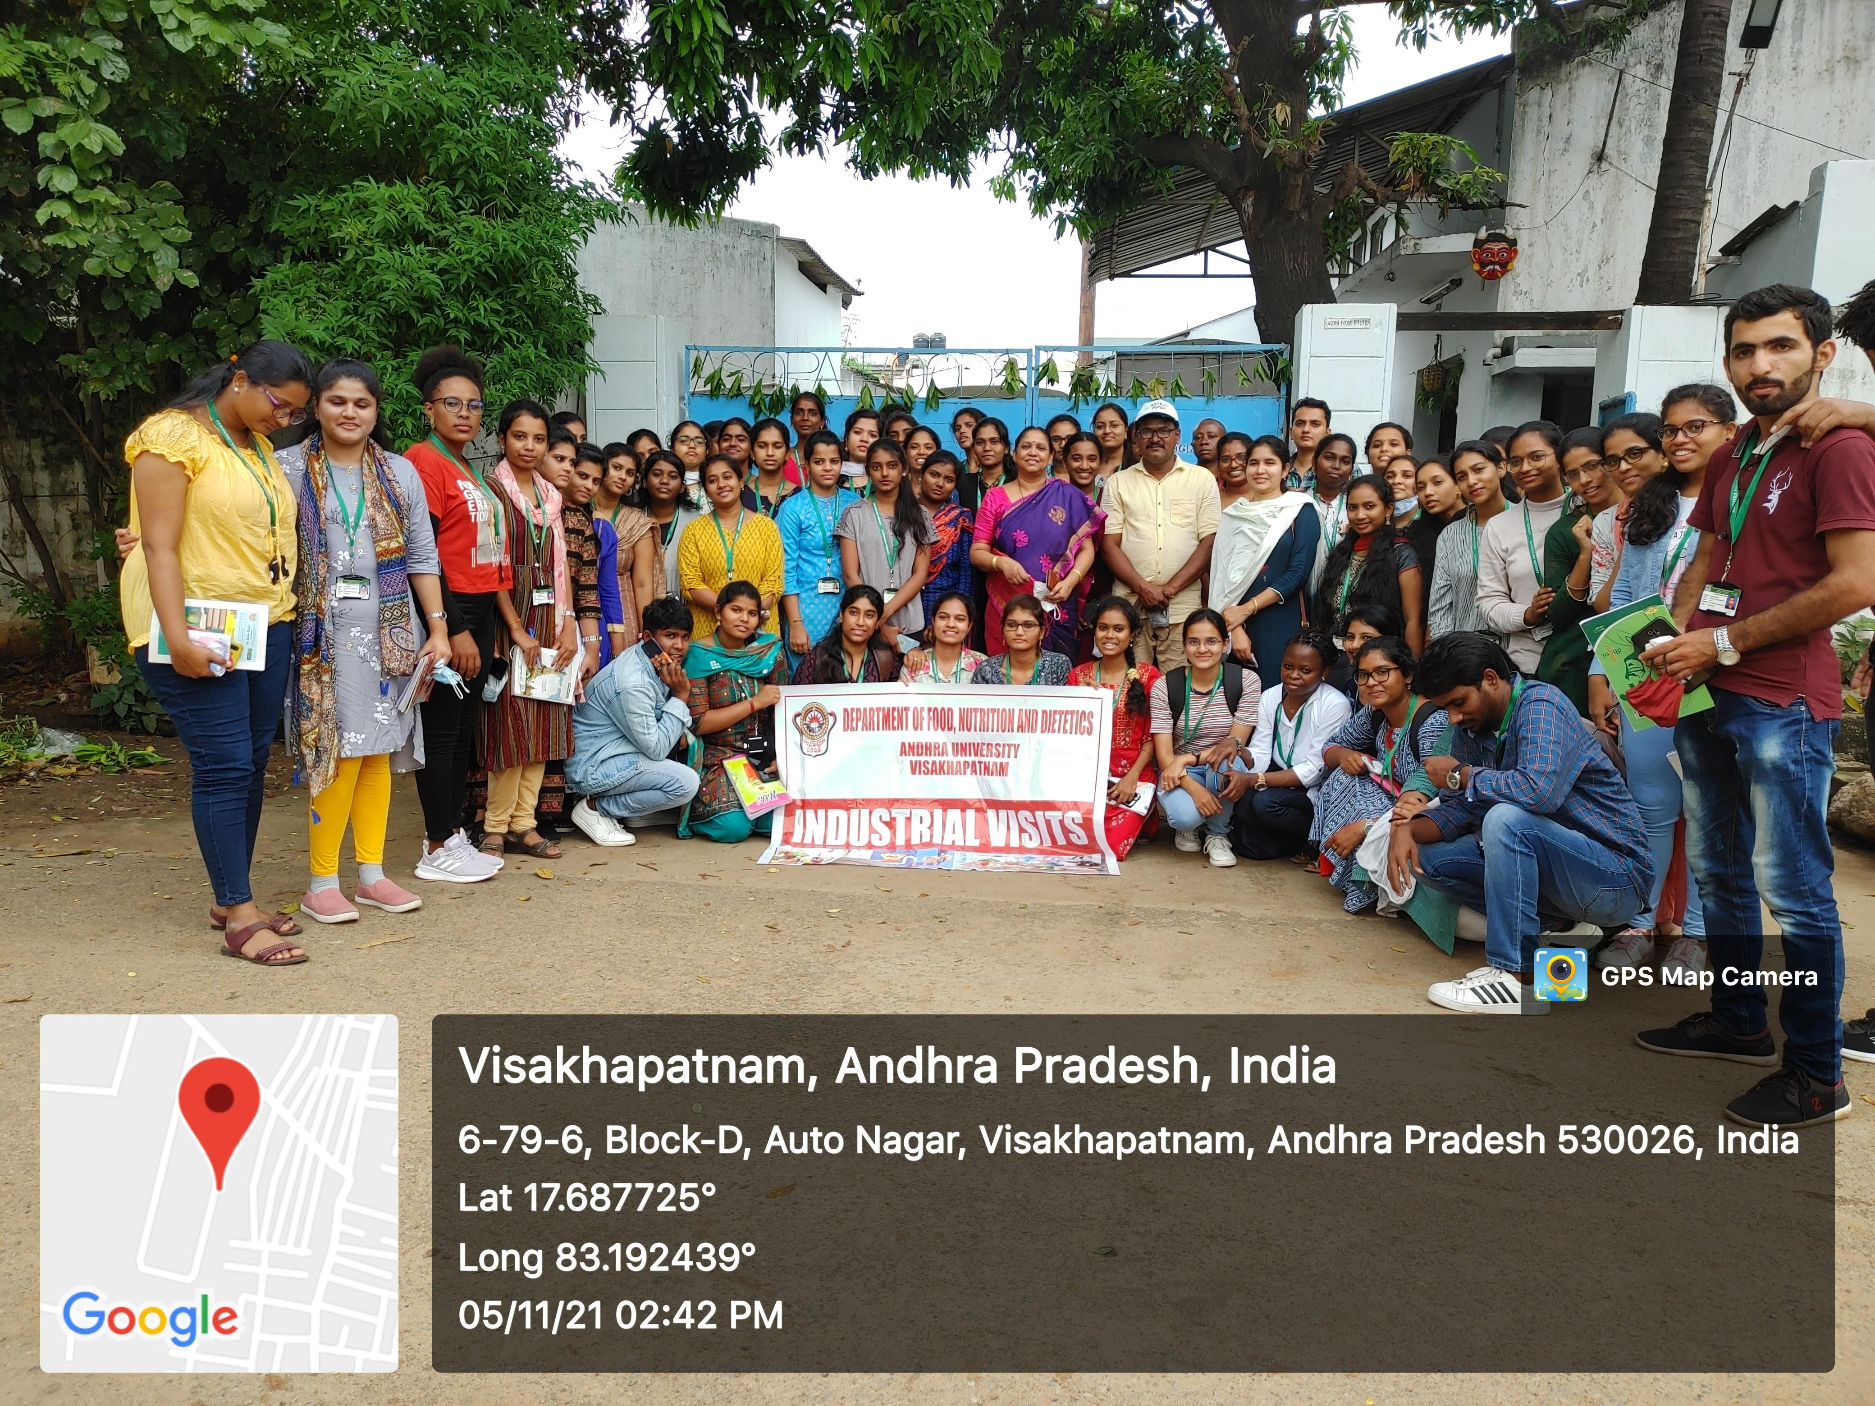
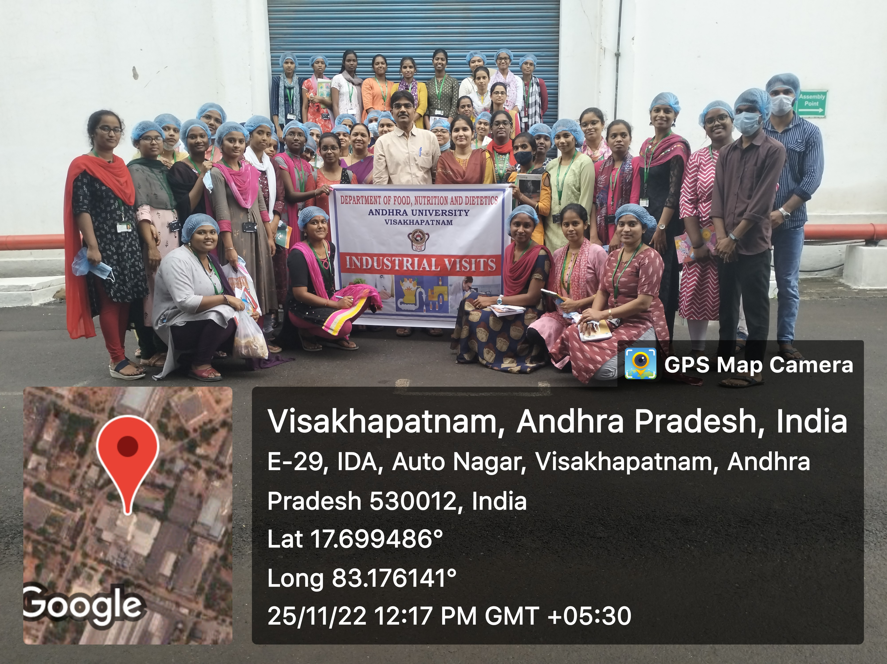
VISIT TO FOOD INDUSTRIES

Slide 31
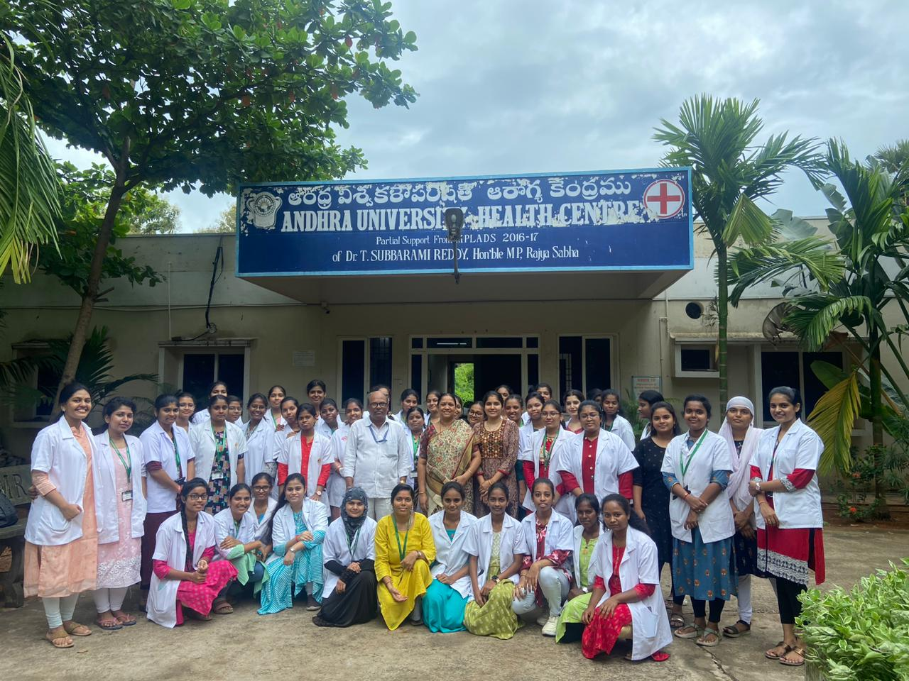
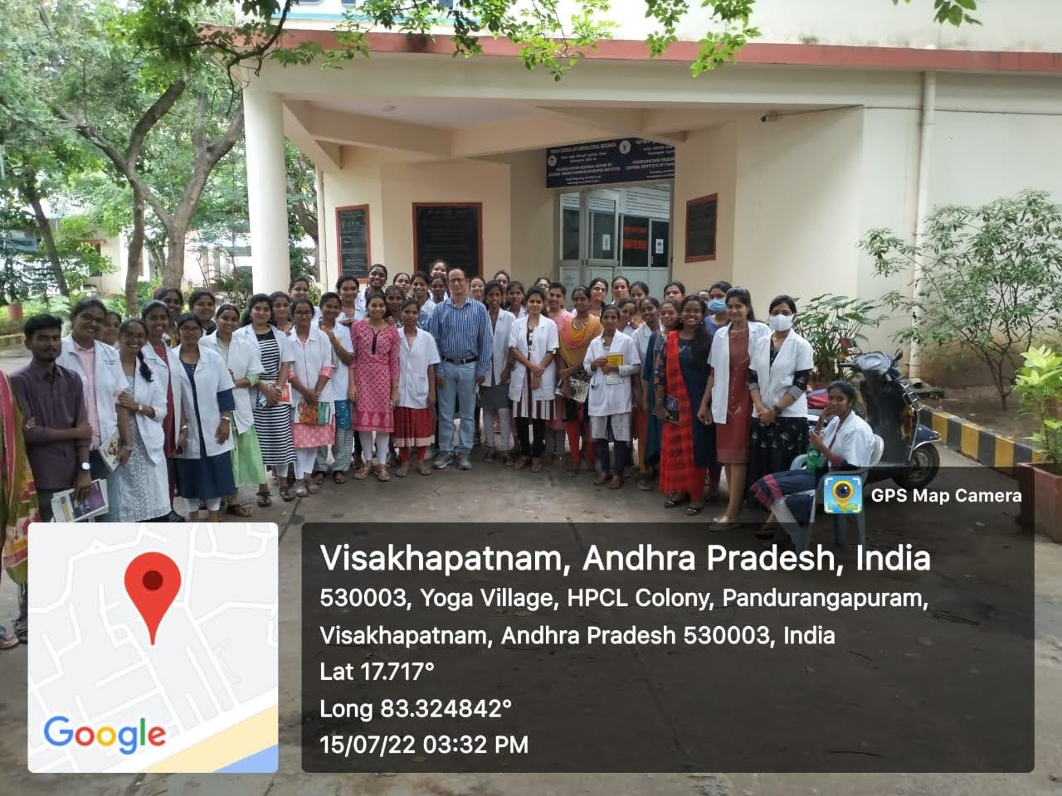
Visit to AU HEALTH CENTRE as a part of Nutrition Biochemistry practical
Visit to CIFT as a part of Food Processing & Preservation practical

Slide 32
SOCIETAL SENSITIZATION programs
Articles in the local newspapers such as Sakshi and Eenadu for creating awareness
Consultancy work for Akshayapatra and ISKCON for diet composition and analysis
Invited talks for AIR during National Nutrition Week, Granules employees and F45 fitness centre
Celebration of World Breast feeding week

Slide 33
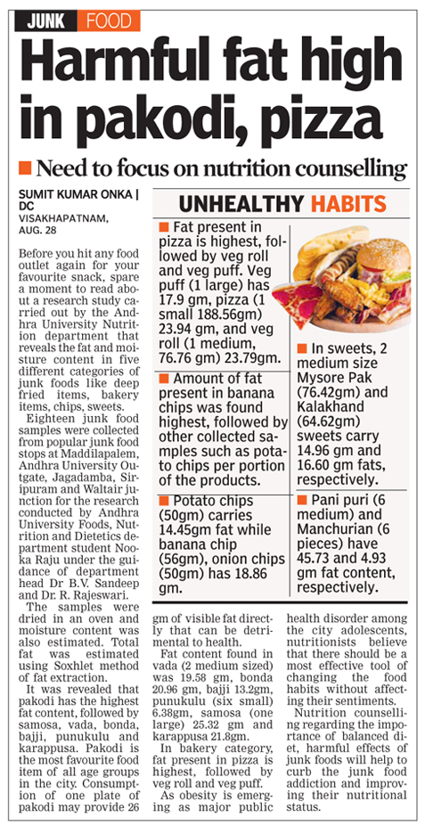
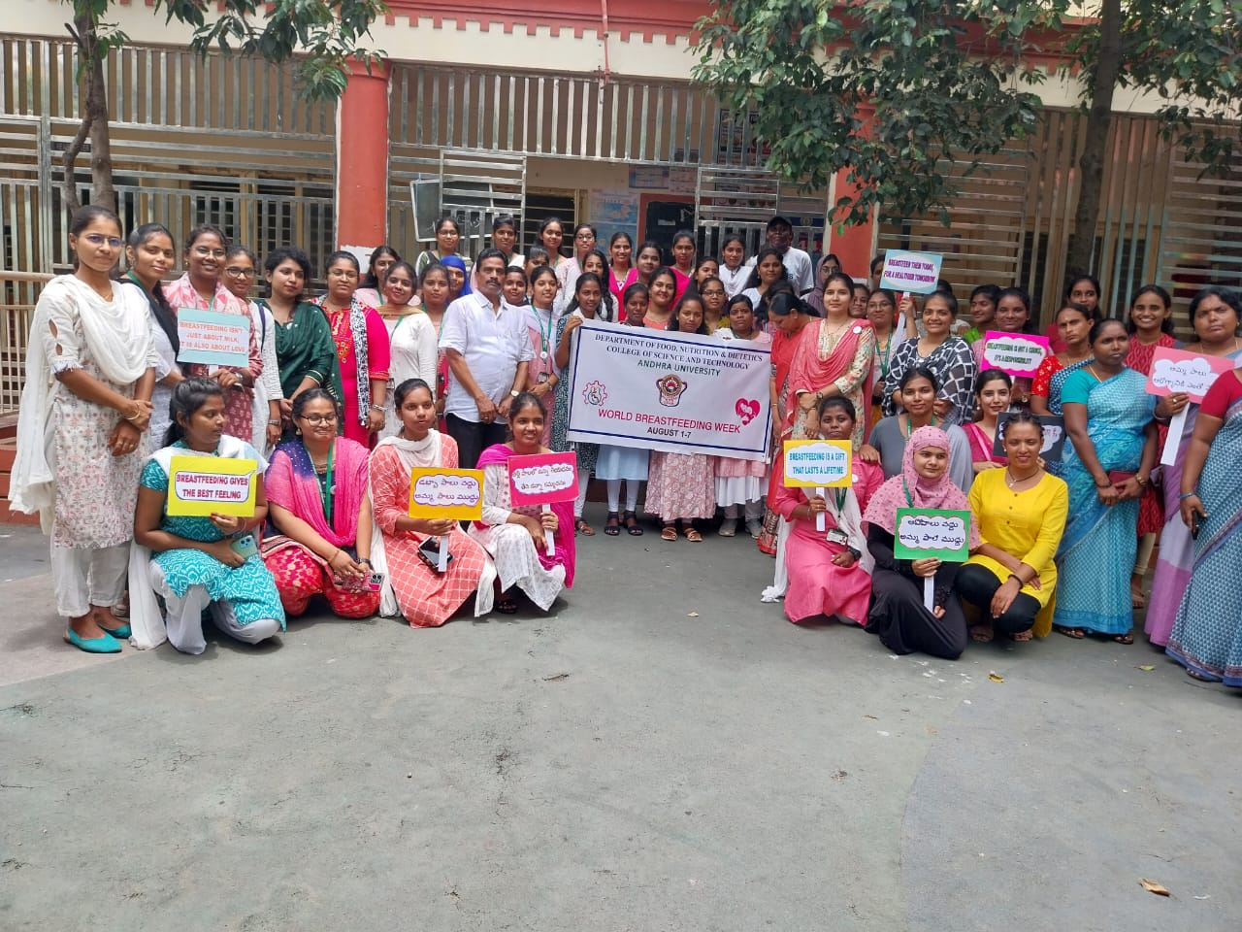
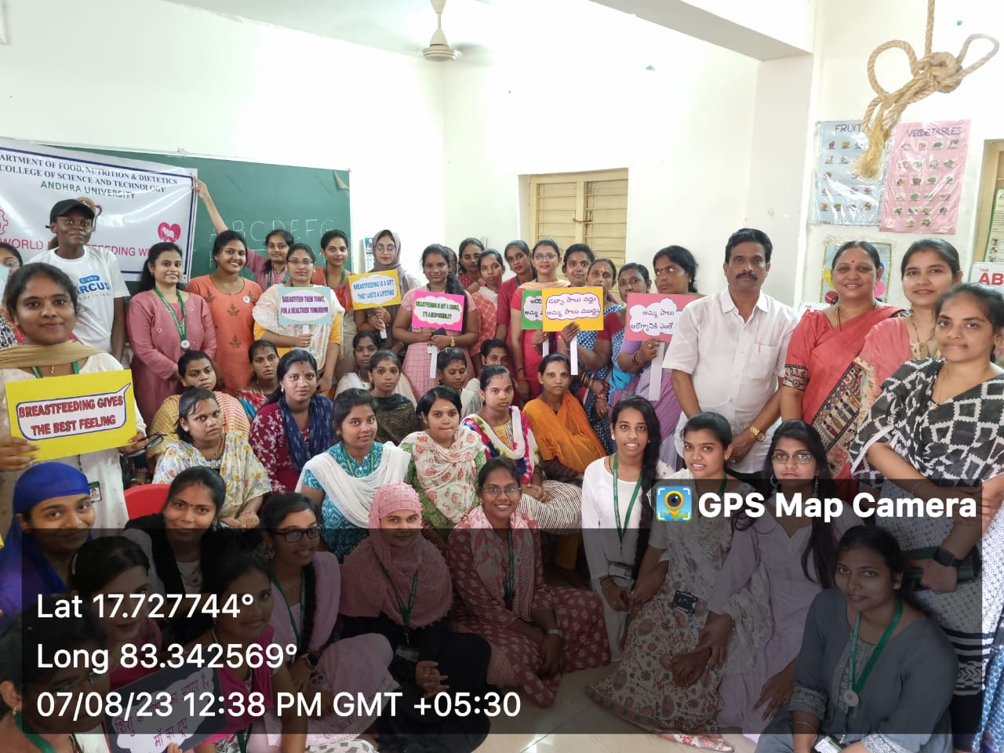
Articles in Newspapers
World Breast Feeding Week

Slide 34
Extension and out reach programs organized
“Demonstration of nutrient rich recipes and nutrition education in 20 villages of Atchutapuram, Anakapalli” supported by Vijaya Vahini Charitable Foundation (Tata Trust).
Prepared a book on menu plans for Pregnant & lactating mothers at ICDS centers, (completed in May 2023)

Slide 35
VILLAGES COVERED
Kondakarala
Bhogapuram
Gurajapalem
Dimili
Krishnampalem
Lalamkudru
Peddapadu
Rajala
Khajipalem
Ganaparthi
Chochukonda
Panchadharla
Gokiwada
Mulajampa
Haripalem
Ramannapalem
Dibbapalem
Munagapaka
Maruturu
Nagulapalli

Slide 37
Equipment
SOLAR DRYER
MUFFLE FURNACE

Slide 38
Prominent Alumni
T. Lavanya
DSL Sravani
A Naga Raju
N Swetha Sree
N Sirisha
Trishita Issar
A. Praveen
Army Dietician
G. Raju
British Biologicals
Director, Diet solutions, Visakhapatnam
Chief Dietitian, KIMS ICON Hospital
Senior Dietitian, Apollo hospitals, Hyderabad
CEO, Suman Television
Division of Nutritional sciences, Cornell University, Ithaca, NY, USA
Senior Nutritionist, Nutraceutical Division, Lee Pharma Ltd

Slide 39
FUTURE PLANS
To establish Diet Counselling Centre catering to the needs of general public
To strengthen efforts towards obtaining patency in the research work undertaken
To start a think tank for startups in food processing

